Slide 1



Music Store Analysis
Home
Music
About Us
Contact
Search . . . .
Music
Music

Slide 2

Music Store Analysis
Home
Music
About Us
Contact
Search . . . .
About Us
About Us
Our project, Music Store Analysis, is a data-driven study conducted using SQL to gain insights into sales trends, artists trend and many more in a music store. We structured our analysis around key predefined questions to extract meaningful insights and improve decision-making.

Slide 3

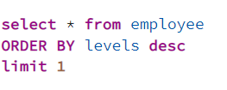
Music Store Analysis
Home
Music
About Us
Contact
Search . . . .
Q1. Who is the senior most employee based on job title?

Slide 4

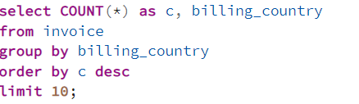
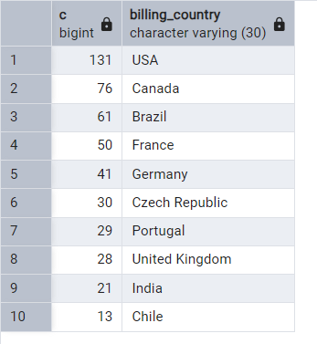
Music Store Analysis
Home
Music
About Us
Contact
Search . . . .
Q2. Which countries have the most Invoices?

Slide 5

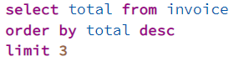

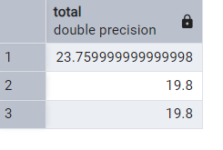
Music Store Analysis
Home
Music
About Us
Contact
Search . . . .
Q3. What are top 3 values of total invoice?

Slide 6
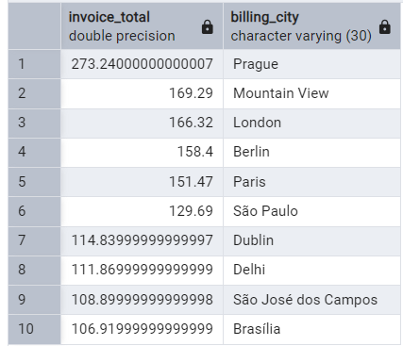
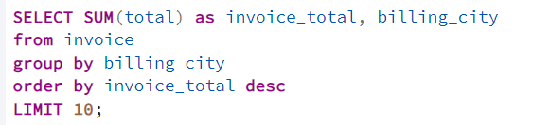
Music Store Analysis
Home
Music
About Us
Contact
Search . . . .
Q4. Which city has the best customers? We would like to throw a promotional Music Festival in the city we made the most money. Write a query that returns one city that has the highest sum of invoice totals. Return both the city name & sum of all invoice totals?

Slide 7

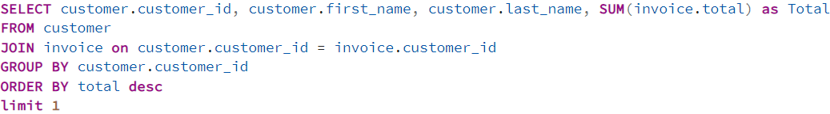
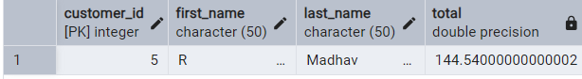
Music Store Analysis
Home
Music
About Us
Contact
Search . . . .
Q5. Who is the best customer? The customer who has spent the most money will be declared the best customer. Write a query that returns the person who has spent the most money?

Slide 8
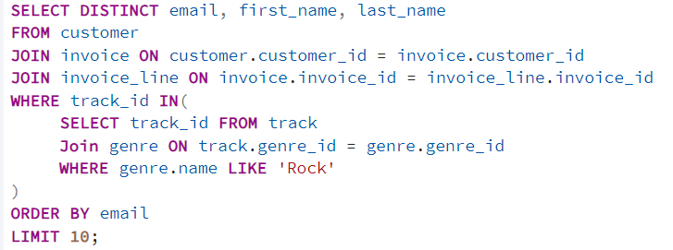
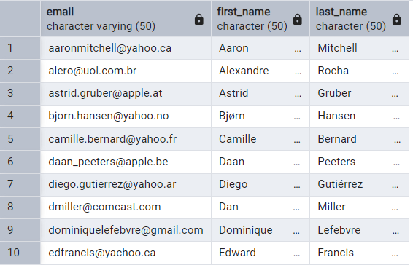
Music Store Analysis
Home
Music
About Us
Contact
Search . . . .
Q6. Write query to return the email, first name, last name, & Genre of all Rock Music listeners. Return your list ordered alphabetically by email starting with A?

Slide 9

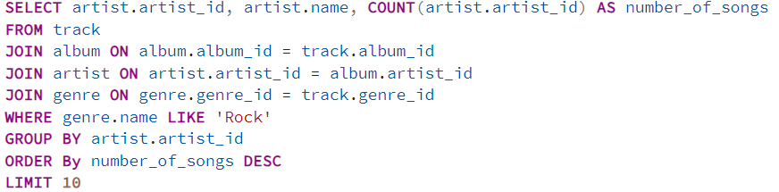
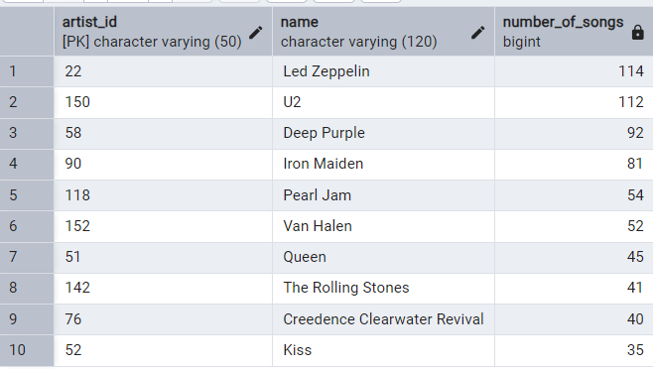
Music Store Analysis
Home
Music
About Us
Contact
Search . . . .
Q7. Let's invite the artists who have written the most rock music in our dataset. Write a query that returns the Artist name and total track count of the top 10 rock bands?

Slide 10
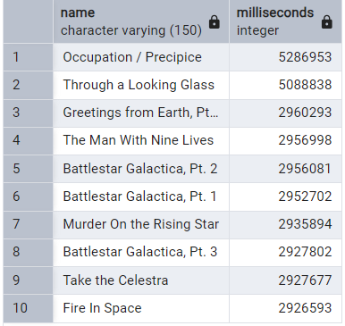
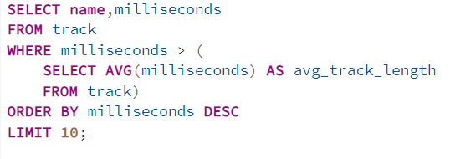
Music Store Analysis
Home
Music
About Us
Contact
Search . . . .
Q8. Return all the track names that have a song length longer than the average song length. Return the Name and Milliseconds for each track. Order by the song length with the longest songs listed first?

Slide 11
Music Store Analysis
Home
Music
About Us
Contact
Search . . . .
Thank
You
For more such projects visit my portfolio https://peerlist.io/abhijeetranjan
Presented By: Abhijeet Ranjan

